Slide 1
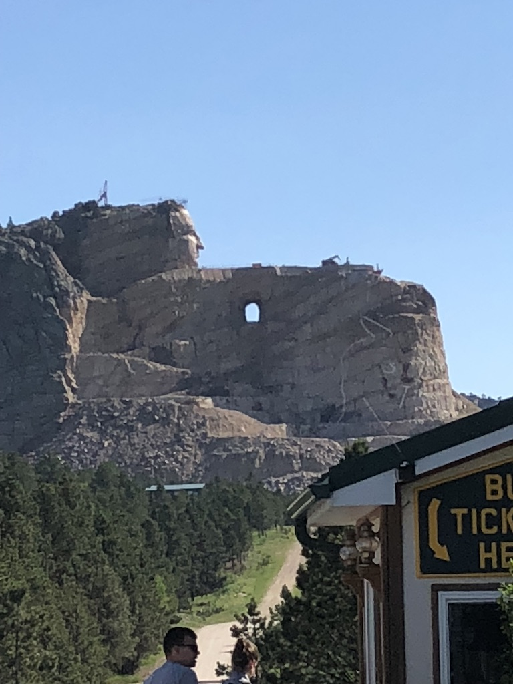
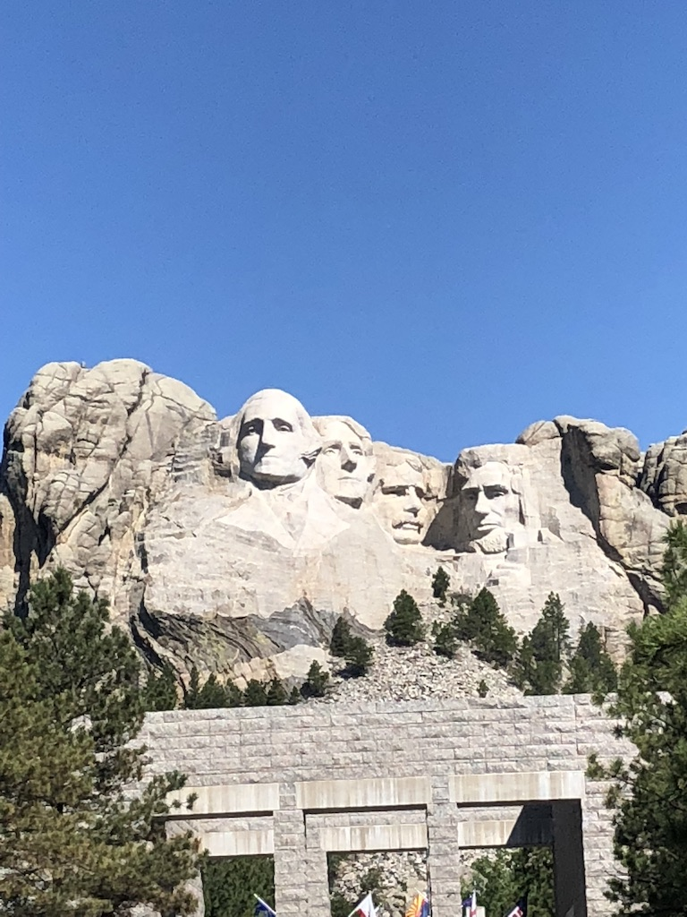
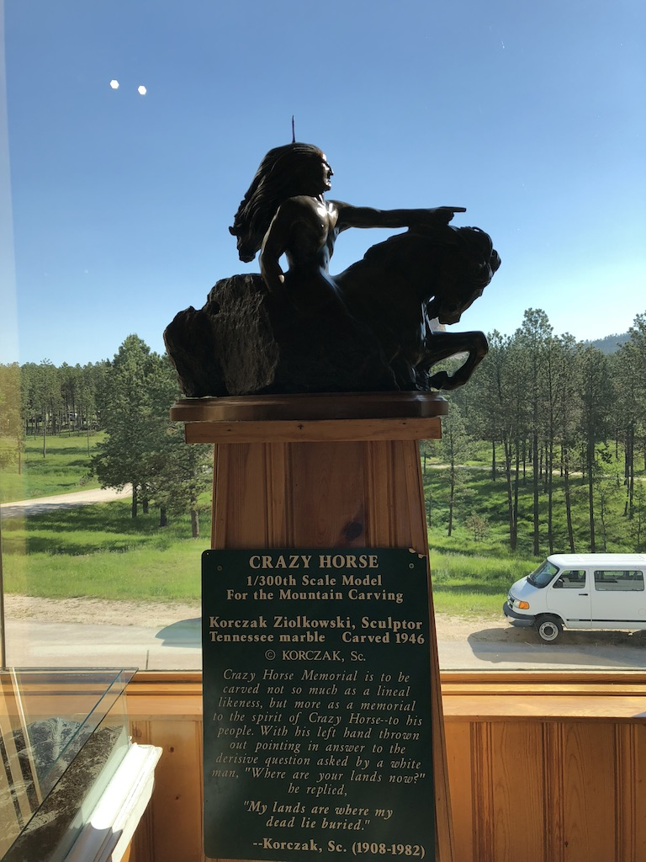
Yay!! Calculations!
Unit 3 – Numerical Summaries
Your Calculating Professor Colton

Slide 2
Unit 3 Outline
Measures of Center
Mean
Median
Best Measure of Center
Mode
Weighted Mean
Examples with Calc

Slide 3
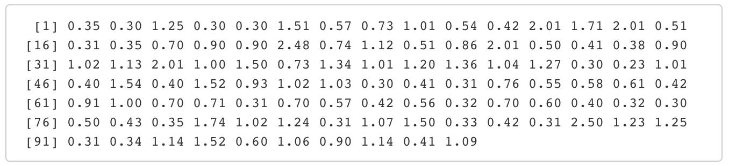
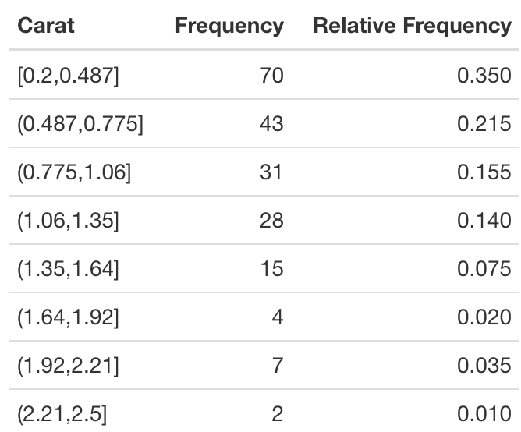
Numerical Summaries Intro
We got data.
We learned how to display it.
But numbers provide great info too.
How can we describe our data??
If we get ONE number, what do we choose?
Edge numbers (min, max), middle (how define middle?), spread numbers (range, others?).
Each choice has its advantages and disadvantages

Slide 4
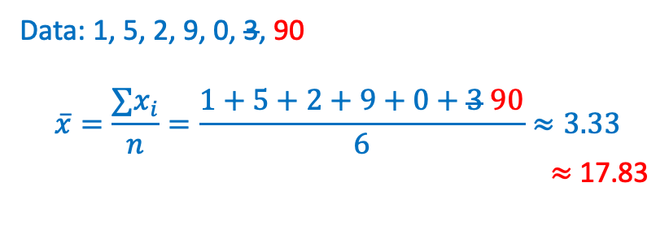
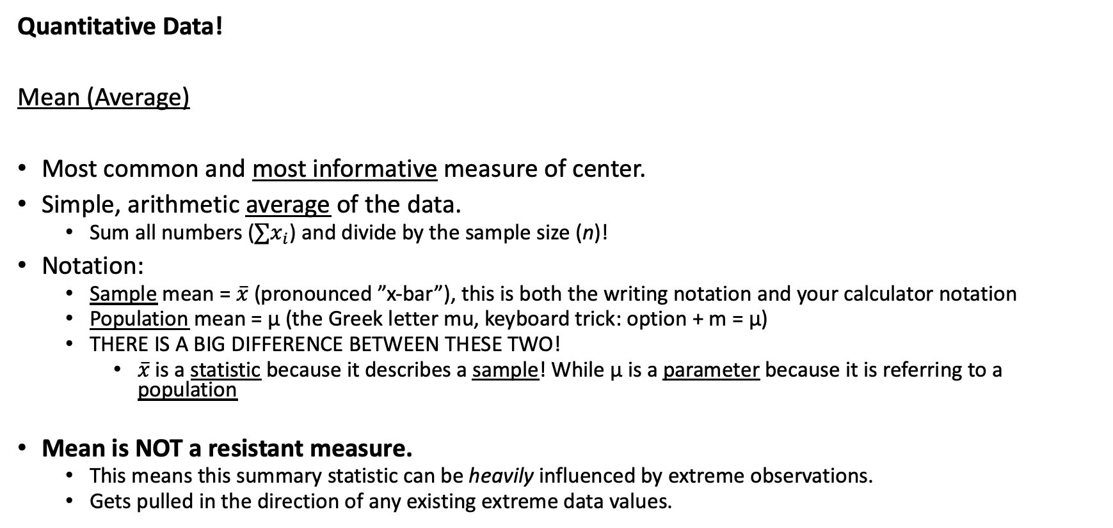
Mean
Data: 1, 5, 2, 9, 0, 3, 90
$$\overline{x}=\frac{∑x_{i}}{n}=\frac{1+5+2+9+0+3 90}{6}≈3.33$$
$≈$ 17.83
Quantitative Data!
Mean (Average)
Most common and most informative measure of center.
Simple, arithmetic average of the data.
Sum all numbers ($∑x_{i}$) and divide by the sample size (n)!
Notation:
Sample mean = $\overline{x}$ (pronounced ”x-bar”), this is both the writing notation and your calculator notation
Population mean = μ (the Greek letter mu, keyboard trick: option + m = µ)
THERE IS A BIG DIFFERENCE BETWEEN THESE TWO!
$\overline{x}$ is a statistic because it describes a sample! While µ is a parameter because it is referring to a population
Mean is NOT a resistant measure.
This means this summary statistic can be heavily influenced by extreme observations.
Gets pulled in the direction of any existing extreme data values.

Slide 5

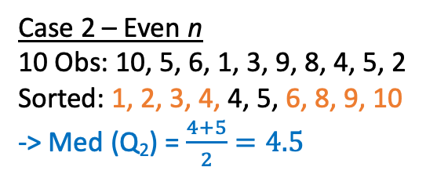

Median
Median
Another measure of center. Less informative than the mean.
It is the middle of the data.
It’s literally just the middle data value when data is ordered smallest to largest
Mini caveat when there is an even number of observations
In which case the median is the average (midpoint) of the two middle values.
Notation:
NOT really regular symbol for median, although it is technically the second Quartile Q₂
On your calculator, it is Med.
Median is considered a resistant measure.
This descriptive statistic is NOT affected by extreme data.
Case 1 – Odd n
9 Obs: 10, 5, 6, 1, 3, 9, 8, 4, 4
Sorted: 1, 3, 4, 4, 5, 6, 8, 9, 10
-> Med (Q₂) = 5
Case 2 – Even n
10 Obs: 10, 5, 6, 1, 3, 9, 8, 4, 5, 2
Sorted: 1, 2, 3, 4, 4, 5, 6, 8, 9, 10
-> Med (Q₂) = $\frac{4+5}{2}=4.5$

Slide 6
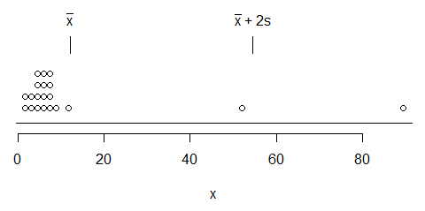

Best Measure of Center - Visual
GOAL: Choose the best measure of center!
Mean
It was pulled upwards from the two outliers
So there are only three observations above it and 16 observations below
Doesn’t really capture the middle of the bulk of the data
Median
It is actually in the middle of the majority of the data because unaffected by the outliers
Gives us the best indication of where the data is centered and is the most appropriate measure

Slide 7
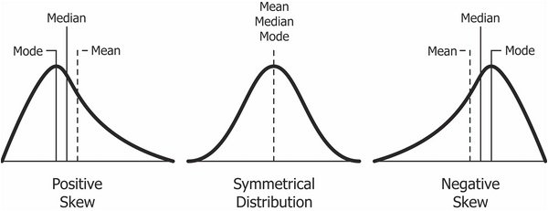
Best Measure of Center
When to Use
Mean is best when…
Data is symmetric (NOT skewed).
AND NO outliers to pull the mean away from the center.
Mean gets pulled towards the tail of skewed data.
So it no longer accurately represents the majority of the data
It is “falsely inflated” from the few observations in the tail
When this is the case, use the Median.
The median is unaffected by the skewness and therefore would now be the MOST APPROPRIATE measure of center.
In other words, it better represents the center point where the data is spread around
Comparison
BOTH measure center, but differently.
Mean actually uses the VALUES of each data point → MOST INFORMATIVE
Median (for the most part) ONLY uses the POSITION of each data point.
This is why mean is NOT resistant while median resistant.
Mean and median are equal here, so use the most informative one!
EXCEL DEMO
https://www.quora.com/What-does-SKEWED-DISTRIBUTION-mean

Slide 8
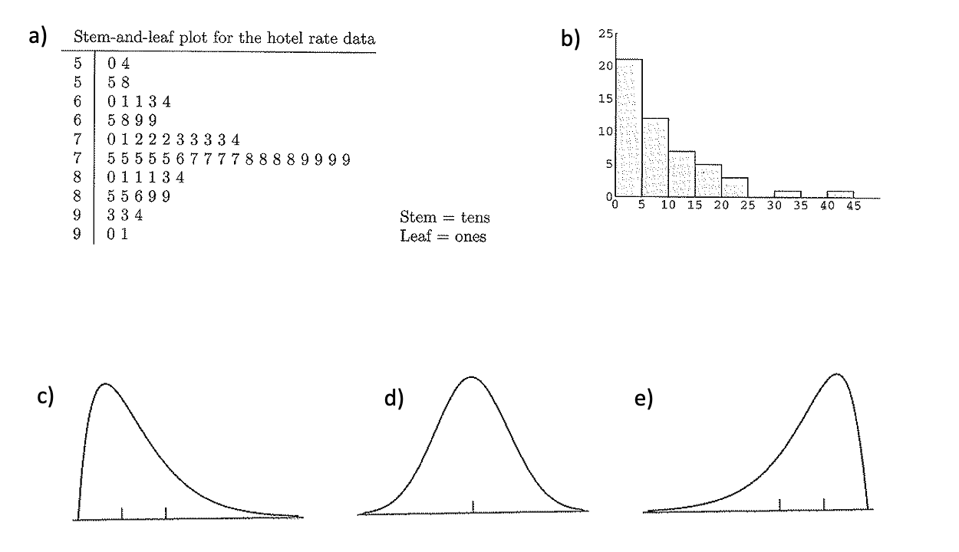
IMPORTANT LCQ: Best Measure of Center
Which measure of center is needed?????

Slide 9
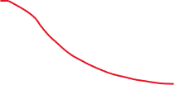
IMPORTANT LCQ: Best Measure of Center
Which measure of center is needed?????
Decisions
Start by thinking we should use the mean because it is the most informative
Then check if it is still appropriate to use the mean with the two below (can think of these as “tests” or “conditions” that the distribution needs to pass)
Shape: Symmetric or skewed?
No outliers or outliers?
Mean
Median
Median
Mean
Median

Slide 10
LCQ: Measure of Center and Shape
Use the values of the sample mean and the sample median to determine whether the distribution is symmetric, skewed left, or skewed right.
Sample mean = 67 Sample Median = 49
b) Sample mean = 23.5 Sample Median = 23.5
c) Sample mean = -17 Sample Median = -6

Slide 11
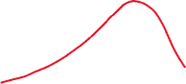



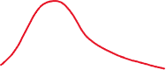
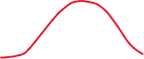

LCQ: Measure of Center and Shape
Use the values of the sample mean and the sample median to determine whether the distribution is symmetric, skewed left, or skewed right.
Sample mean = 67 Sample Median = 49
Sample mean > Sample Median, Skewed right
b) Sample mean = 23.5 Sample Median = 23.5
Sample Mean ≈ Sample Median, Symmetric
c) Sample mean = -17 Sample Median = -6
Sample Mean < Sample Median, Skewed left
Long tail on right
Equal tails on both sides
Long tail on left

Slide 12
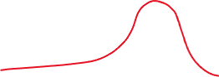
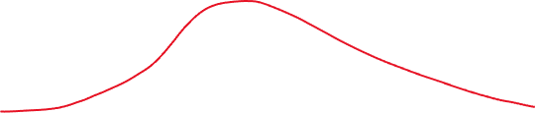
Just comparing the mean vs the median to determine the shape of a distribution could be misleading
We also have to take into account the scale or the range of the entire distribution to get a clear idea of the shape

Slide 13
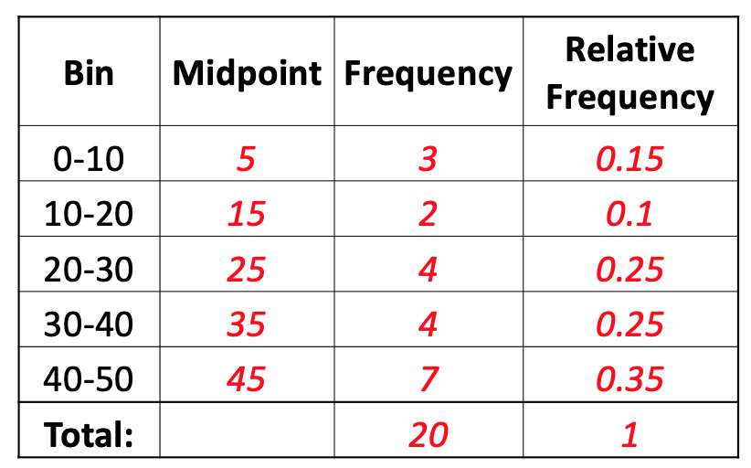
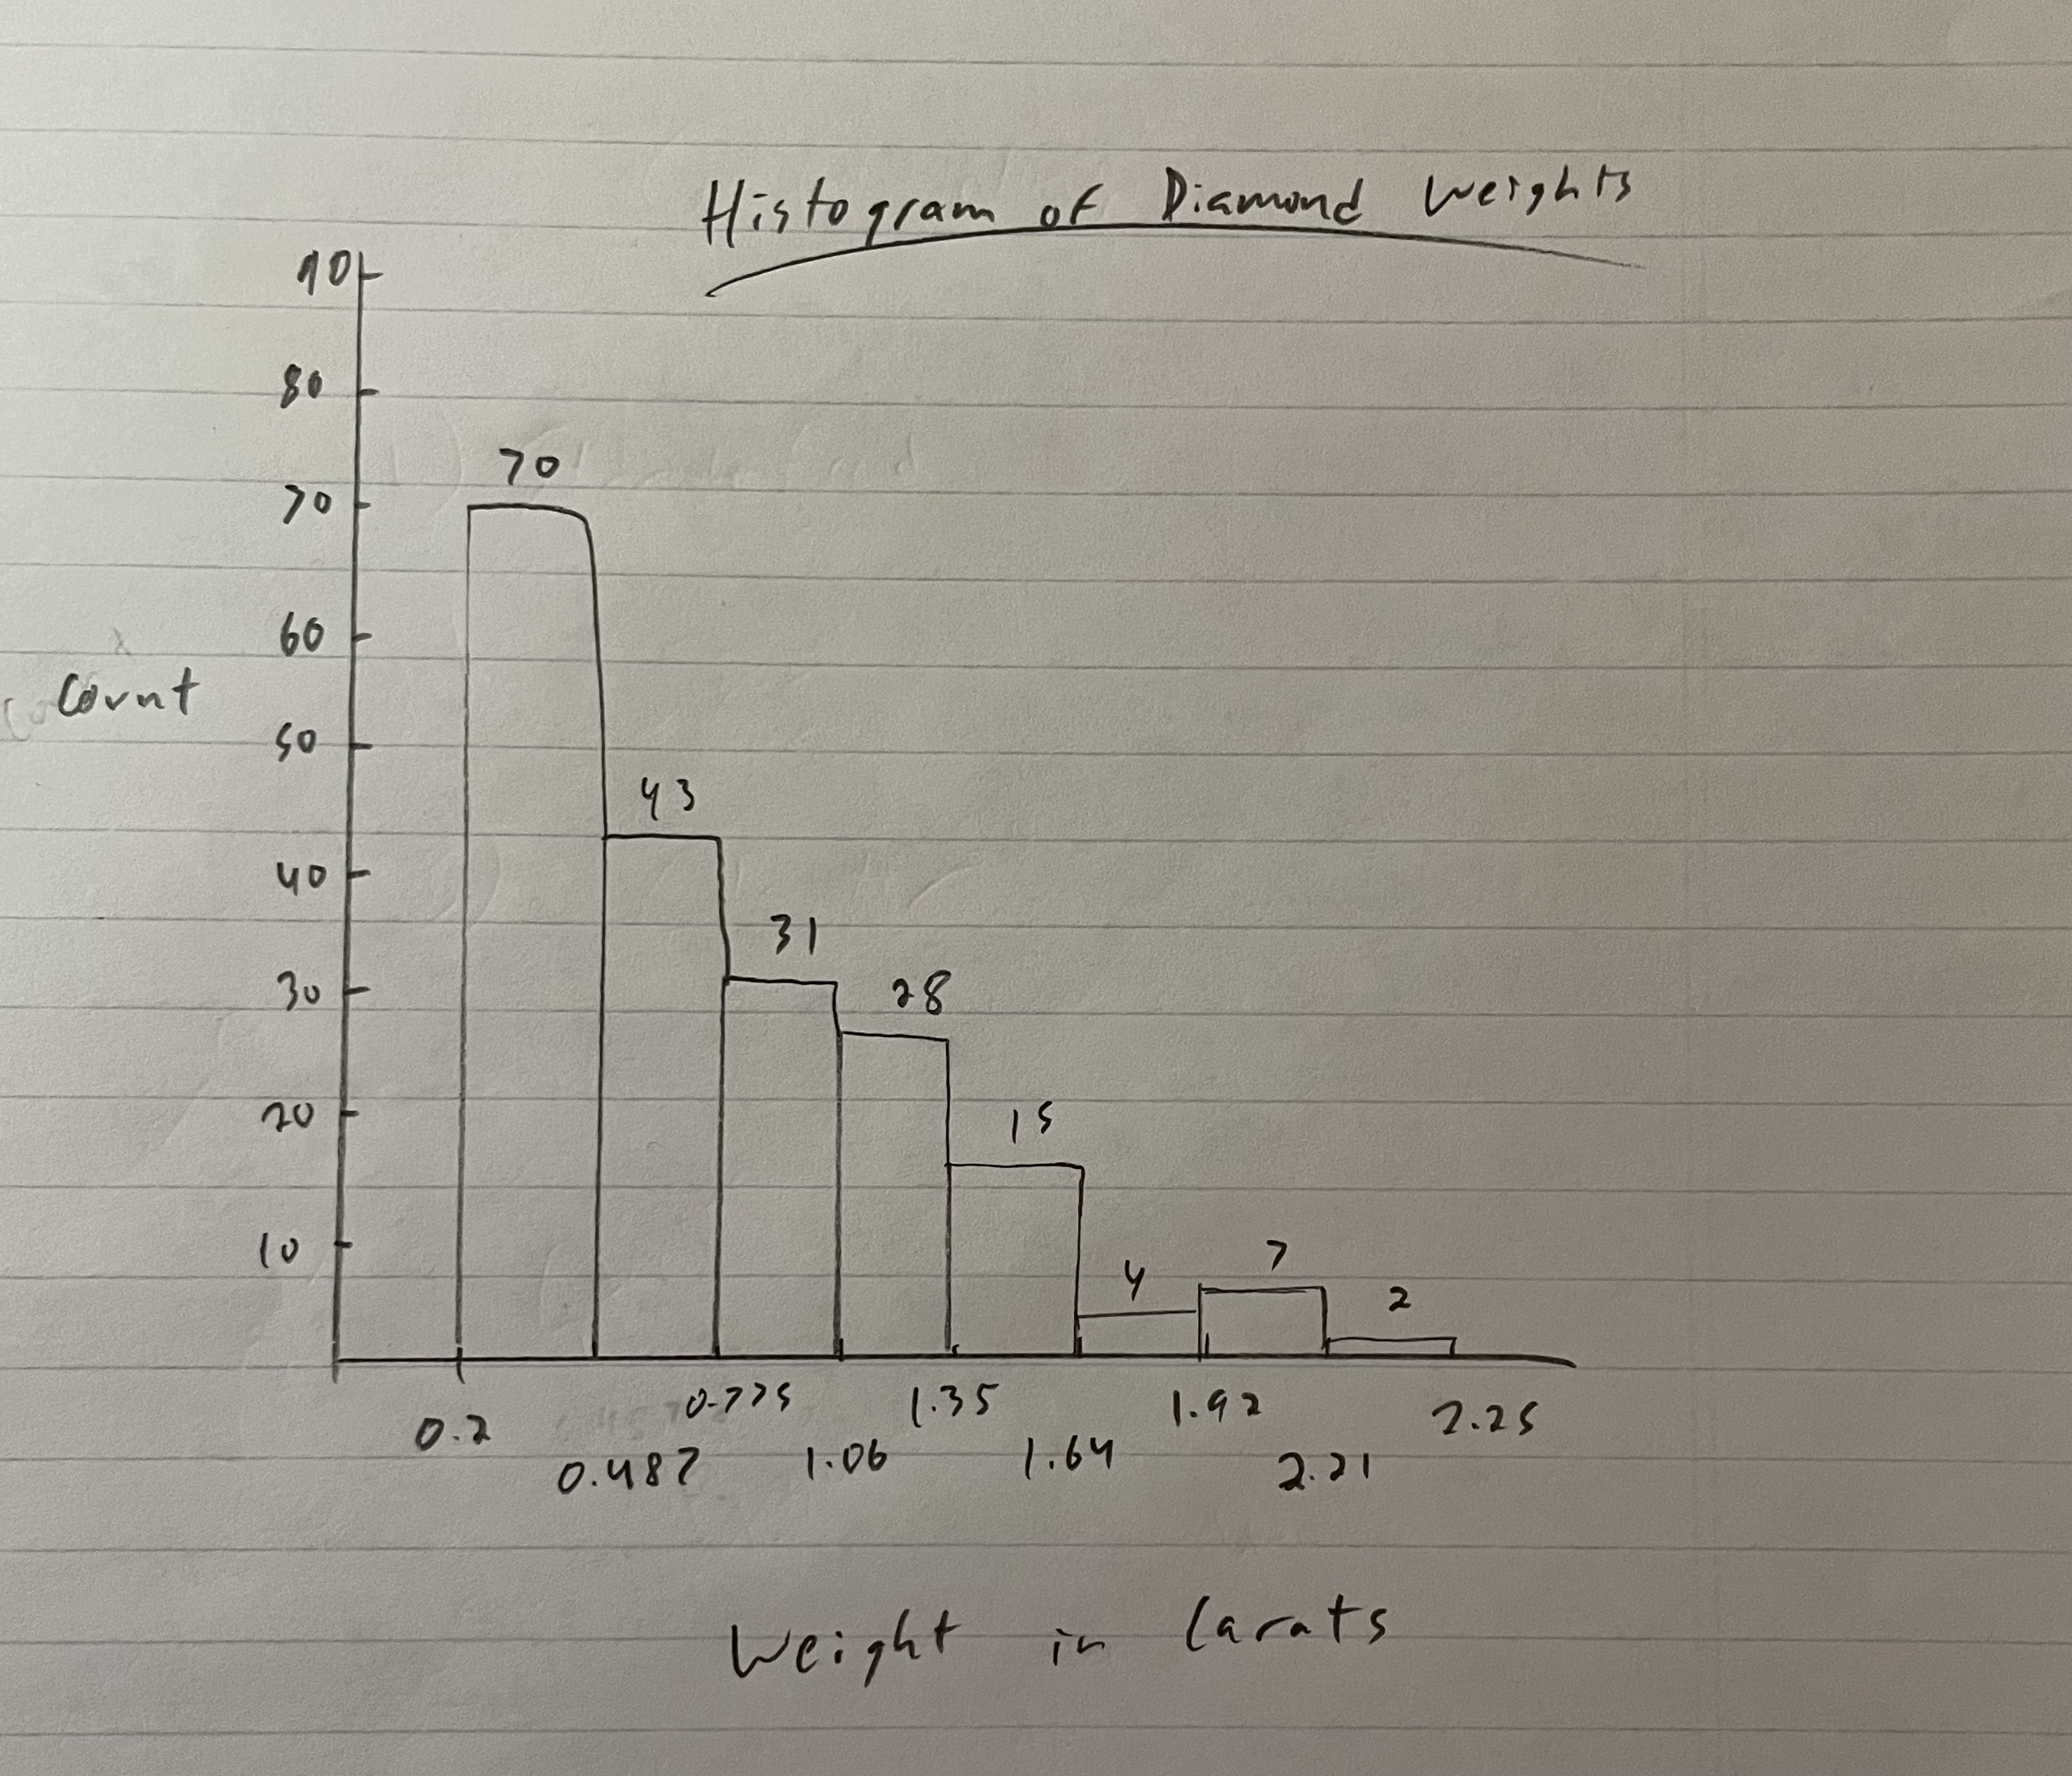
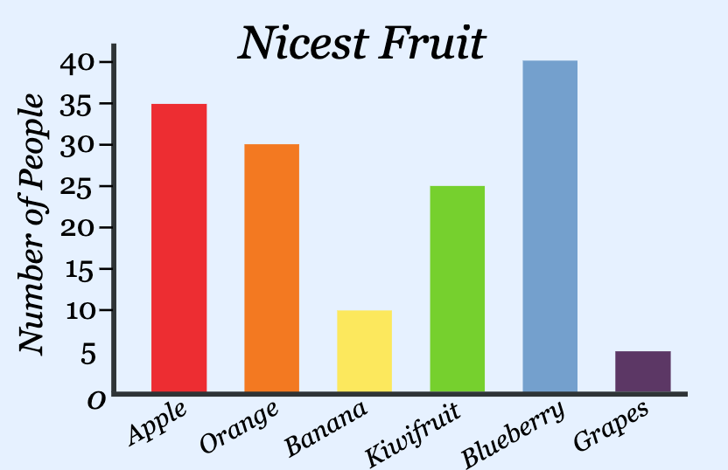

Mode
Mode
Mode
Mode
Most common data value.
If all data occur the same number of times, there is no mode.
Can have more than one mode.
Frequency Tables and Histograms
The actual value for the mode is identified by the midpoint of the class (bin) that contains the most data.
It is sometimes called the modal class.
The Mode is the ONLY measure of center that works with qualitative data as well.
Mode
https://www.mathsisfun.com/data/bar-graphs.html

Slide 14
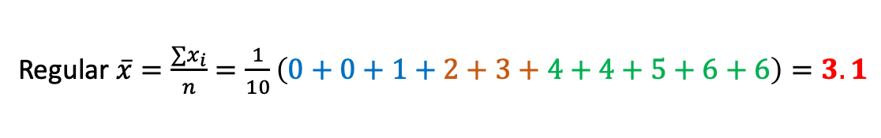
Weighted Mean
Weighted Mean (Mean of Grouped Data)
Used for Frequency Tables, when we don’t have the raw data.
Uses midpoints to estimate each class and frequencies to provide "weight" for each class.
Simple Example:
Data (10 obs):
0, 1, 2, 3, 3, 4, 4, 5, 6, 6
Regular $\overline{x}=\frac{∑x_{i}}{n}=\frac{1}{10}\left(0+0+1+2+3+4+4+5+6+6\right)=3.1$
Bin | Midpoint | Frequency
0-2 | (0+2)/2 = 1 | 3
2-4 | 3 | 2
4-6 | 5 | 5
Weighted $\overline{x}=\frac{∑m_{1}+∑m_{2}+∑m_{3}}{n}=\frac{1}{10}\left(1+1+1+3+3+5+5+5+5+5\right)=3.4$

Slide 15
Calculator Fun Session 2!!!!

Slide 16
LCQ / Example 1: 1-Var Stats
GOAL: Find some Descriptive (Summary) Stats!
Enter data in L₁ (15 obs):
10, 23, 4, 6, 9, 3, 15, 6, 12, 11, 19, 10, 6, 8, 15
1-Var Stats
List is L₁.
Leave FreqList blank.
Calculate!
Interpret results:
Let’s say this data is from a sample of the number of eggs hens laid in the month.
Find the mean. Show your work. Interpret in context.

Slide 17
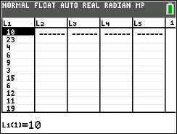
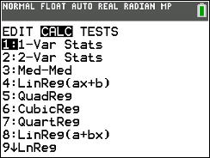
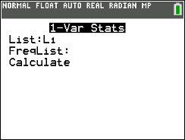
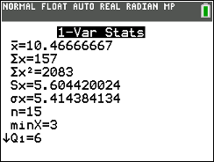
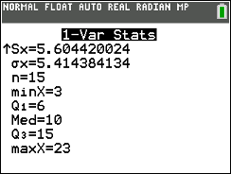
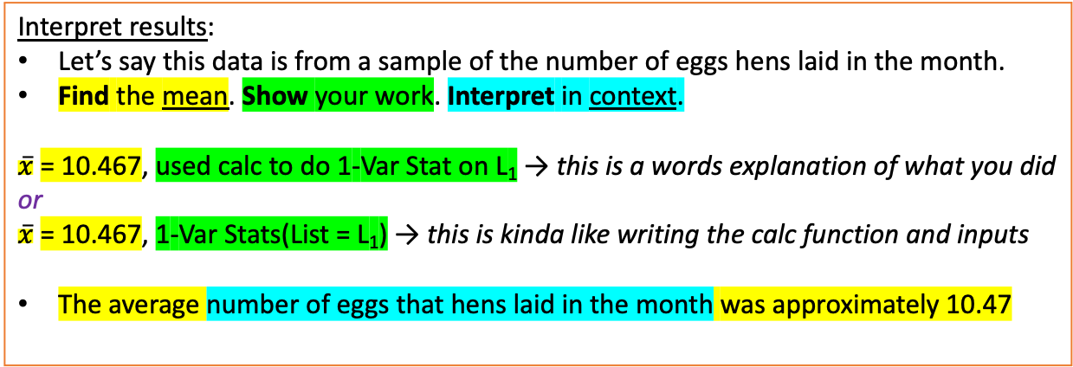
LCQ / Example 1: 1-Var Stats
GOAL: Find some Descriptive (Summary) Stats!
Enter data in L₁ (15 obs):
10, 23, 4, 6, 9, 3, 15, 6, 12, 11, 19, 10, 6, 8, 15
1-Var Stats
List is L₁.
Leave FreqList blank.
Calculate!
Interpret results:
Let’s say this data is from a sample of the number of eggs hens laid in the month.
Find the mean. Show your work. Interpret in context.
$\overline{x}$= 10.467, used calc to do 1-Var Stat on L₁ → this is a words explanation of what you did
or
$\overline{x}$= 10.467, 1-Var Stats(List = L₁) → this is kinda like writing the calc function and inputs
The average number of eggs that hens laid in the month was approximately 10.47
Could also calculate and show work via Excel, such as x-bar = AVERAGE(A1:A15)
But need to get comfortable using calc and calc is just easier and gives more info ☺

Slide 18
LCQ / Example 2: Weighted Mean
Bin | Midpoint | Frequency
0-10 |  | 3
10-20 |  | 2
20-30 |  | 5
30-40 |  | 4
40-50 |  | 6
GOAL: Find the Weighted Mean!
Calculate Midpoints of each bin.
Enter data.
Midpoints (our estimates) go in L₁.
Frequencies (our weights) go in L₂.
1-Var Stats
List is L₁ (Midpoints).
FreqList is L₂ (Frequencies).
Calculate!
Interpret results:
Let’s say this data is about the number of homework assignments students had last semester in all of their classes.
Find the weighted mean. Show you work. Interpret in context.

Slide 19
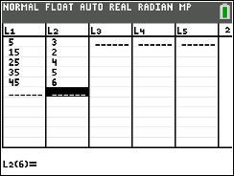
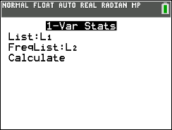
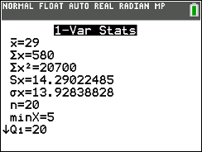
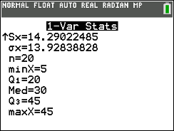
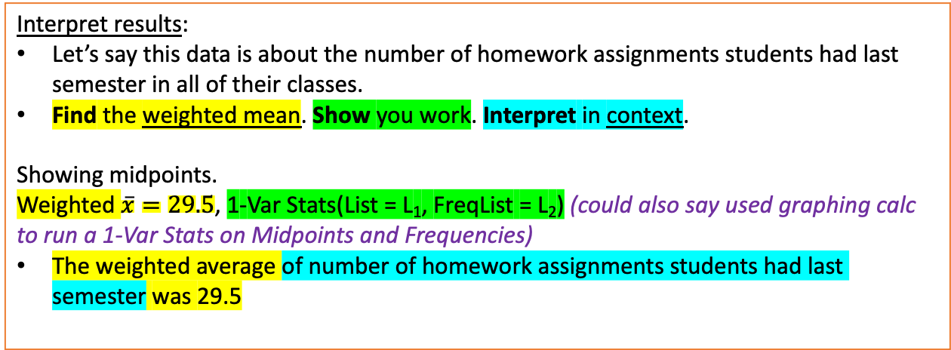
LCQ / Example 2: Weighted Mean
Bin | Midpoint | Frequency
0-10 | (0+10)/2 = 5 | 3
10-20 | (10+20)/2 = 15 | 2
20-30 | 25 | 5
30-40 | 35 | 4
40-50 | 45 | 6
GOAL: Find the Weighted Mean!
Calculate Midpoints of each bin.
Enter data.
Midpoints (our estimates) go in L₁.
Frequencies (our weights) go in L₂.
1-Var Stats
List is L₁ (Midpoints).
FreqList is L₂ (Frequencies).
Calculate!
Interpret results:
Let’s say this data is about the number of homework assignments students had last semester in all of their classes.
Find the weighted mean. Show you work. Interpret in context.
Showing midpoints.
Weighted $\overline{x}=29.5$, 1-Var Stats(List = L₁, FreqList = L₂) (could also say used graphing calc to run a 1-Var Stats on Midpoints and Frequencies)
The weighted average of number of homework assignments students had last semester was 29.5

Slide 20
LCQ / Example 1: Mode and 5-Number Summary
GOAL: Find the Mode and use the 5-Number Summary to sketch a boxplot!
Enter data in L₁ (12 obs):
90, 86, 60, 73, 77, 94, 83, 90, 90, 87, 80, 71
Sort data.
Then can look at new list to find the Mode easily:
1-Var Stats
Report 5-Number Summary
Sketch a boxplot!

Slide 21
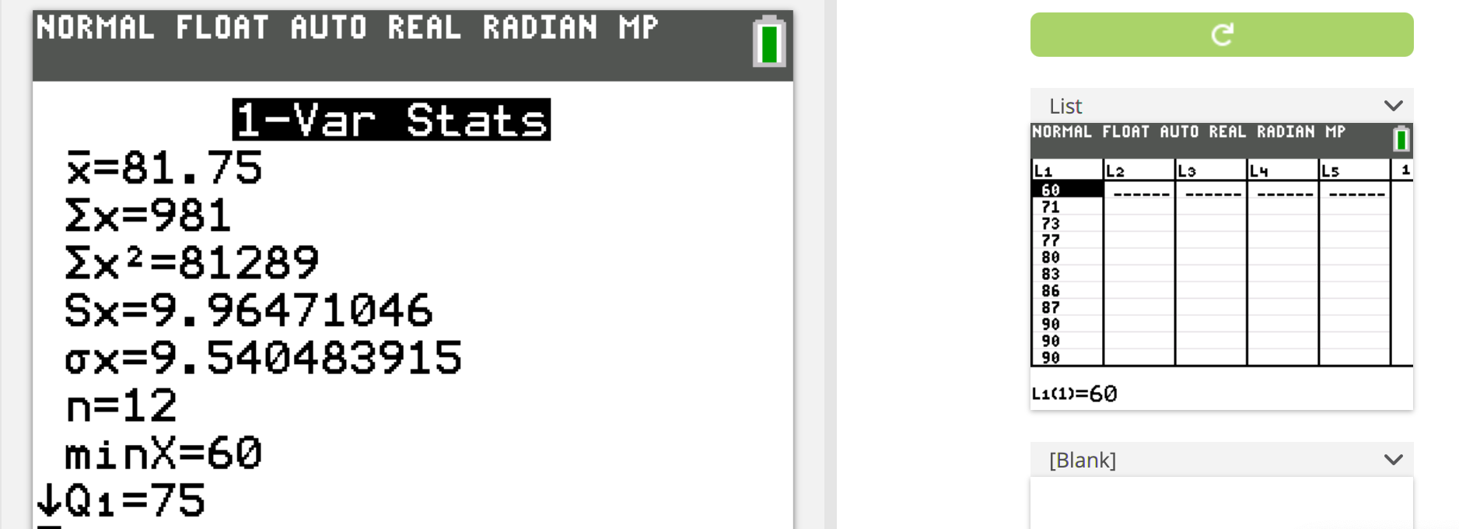
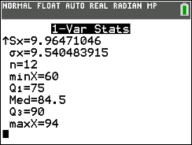
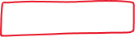
LCQ / Example 1: Mode and 5-Number Summary
GOAL: Find the Mode and use the 5-Number Summary to sketch a boxplot!
Enter data in L₁ (12 obs):
90, 86, 60, 73, 77, 94, 83, 90, 90, 87, 80, 71
Sort data.
Then can look at new list to find the Mode easily: Mode = 90
1-Var Stats
Report 5-Number Summary
Min = 60
Q1 = 75
Med = 84.5
Q3 = 90
Max = 94
Sketch a boxplot!

